Slide 2
What is DragonFly?
Dragonfly is a software that connects coaches, parents, and athletic trainers in regards to health and eligibility status of your child.

Slide 3
Benefits
Know exactly what forms are due
Check child’s AHSAA eligibility status
Get notifications about schedule changes
Option to print from the site (physicals for camps)
Able to update medical information at ANY TIME
Get updated on injury status & rehab plans
Parents have direct access to all submitted forms- no forms changing hands

Slide 4
DATES TO REMEMBER
School Physical: Week of July 14-20
Athletic Department will upload the “new” copy to DragonFly (hard copy kept on file)
AHSAA 2019-2020 forms arrive in DragonFly: June 2019

Slide 5
DRAGONFLY MAX- HOW DO I SIGN UP??
www.dragonflymax.com
OR
Download on your iphone/andriod

Slide 6
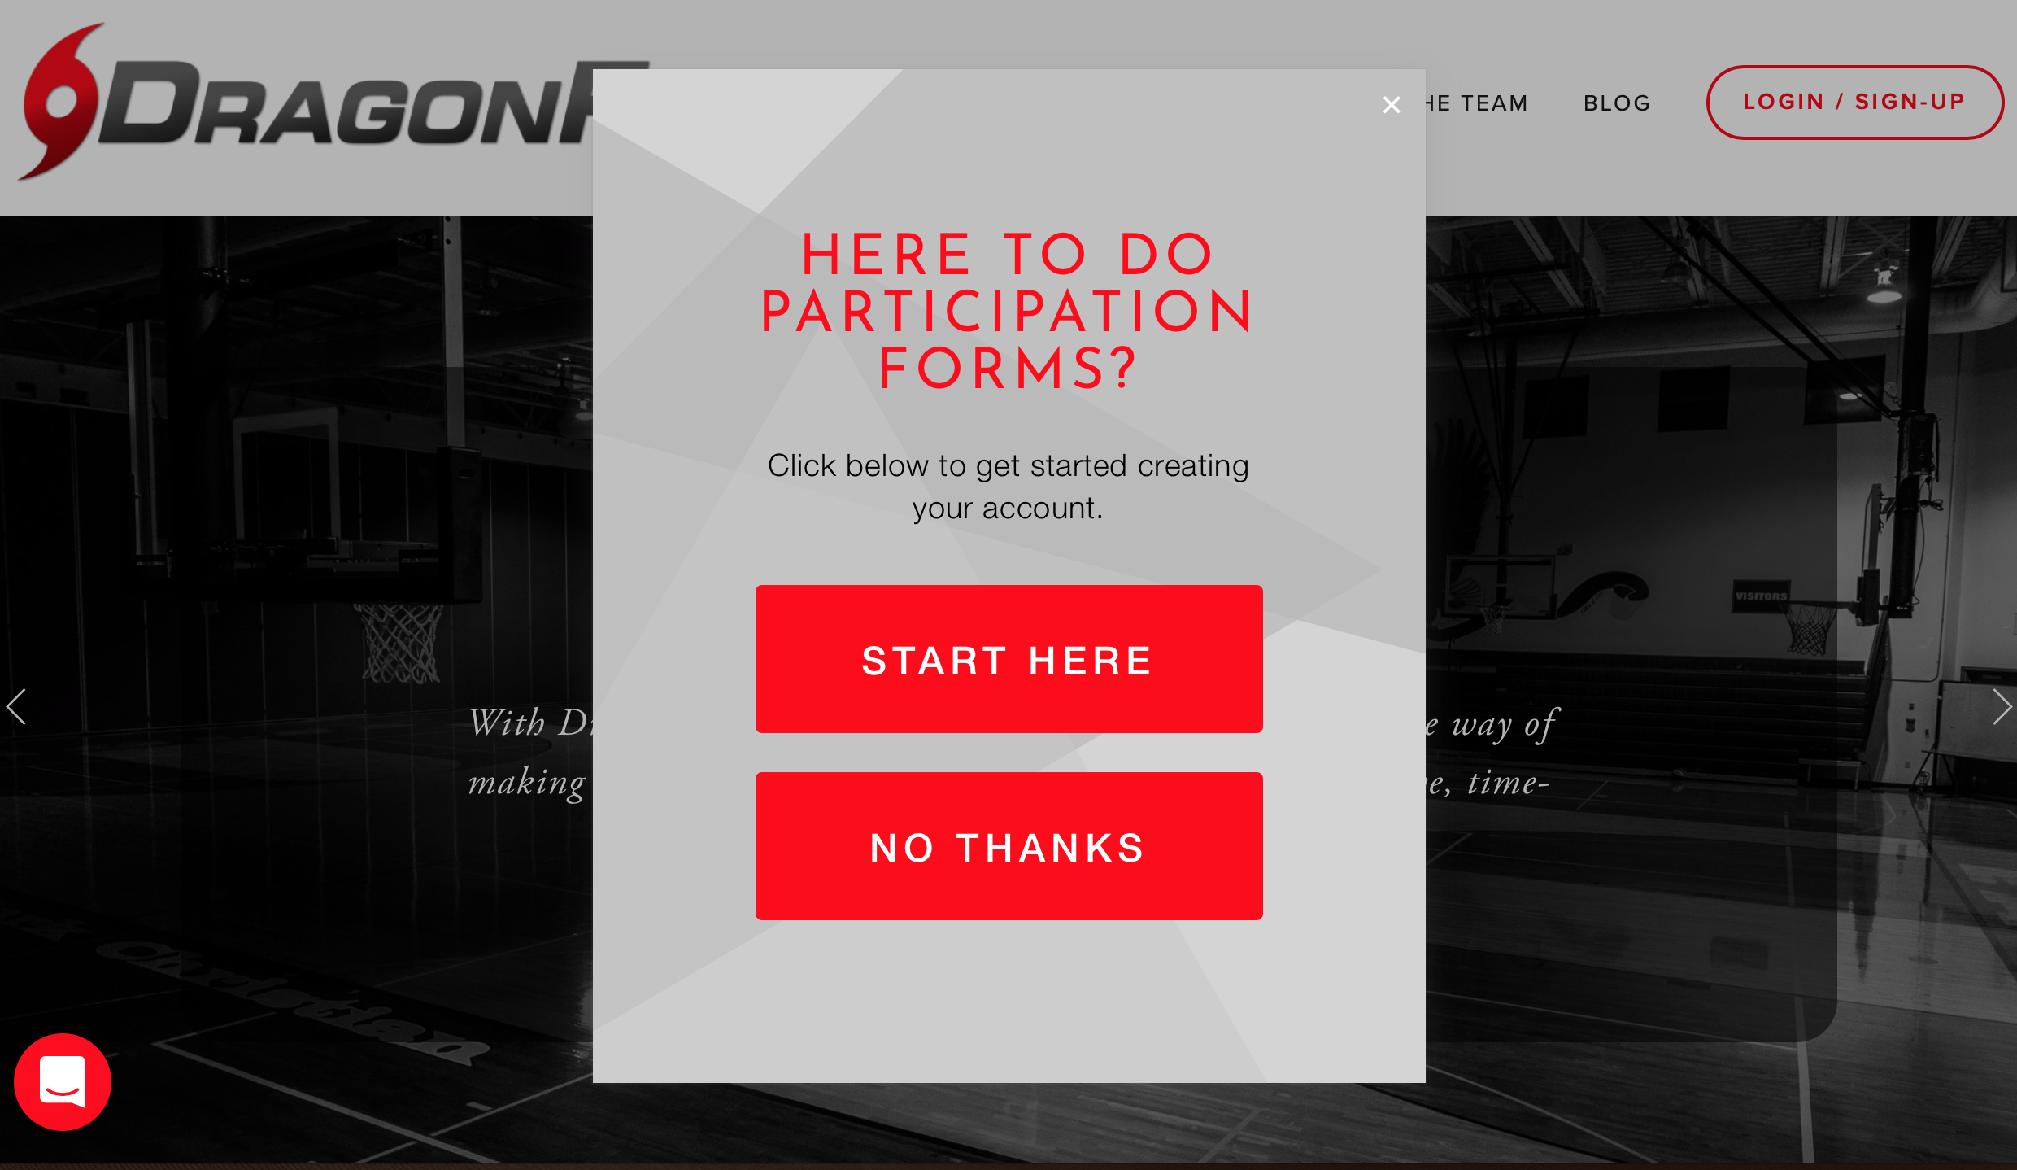

Slide 8
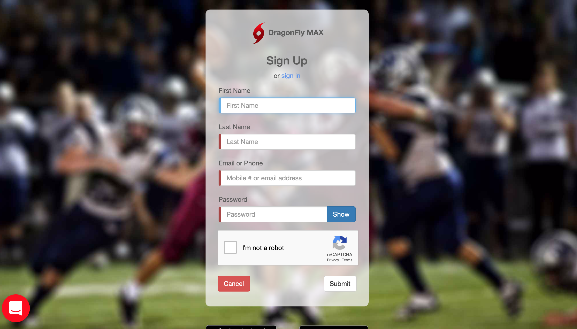

Slide 9
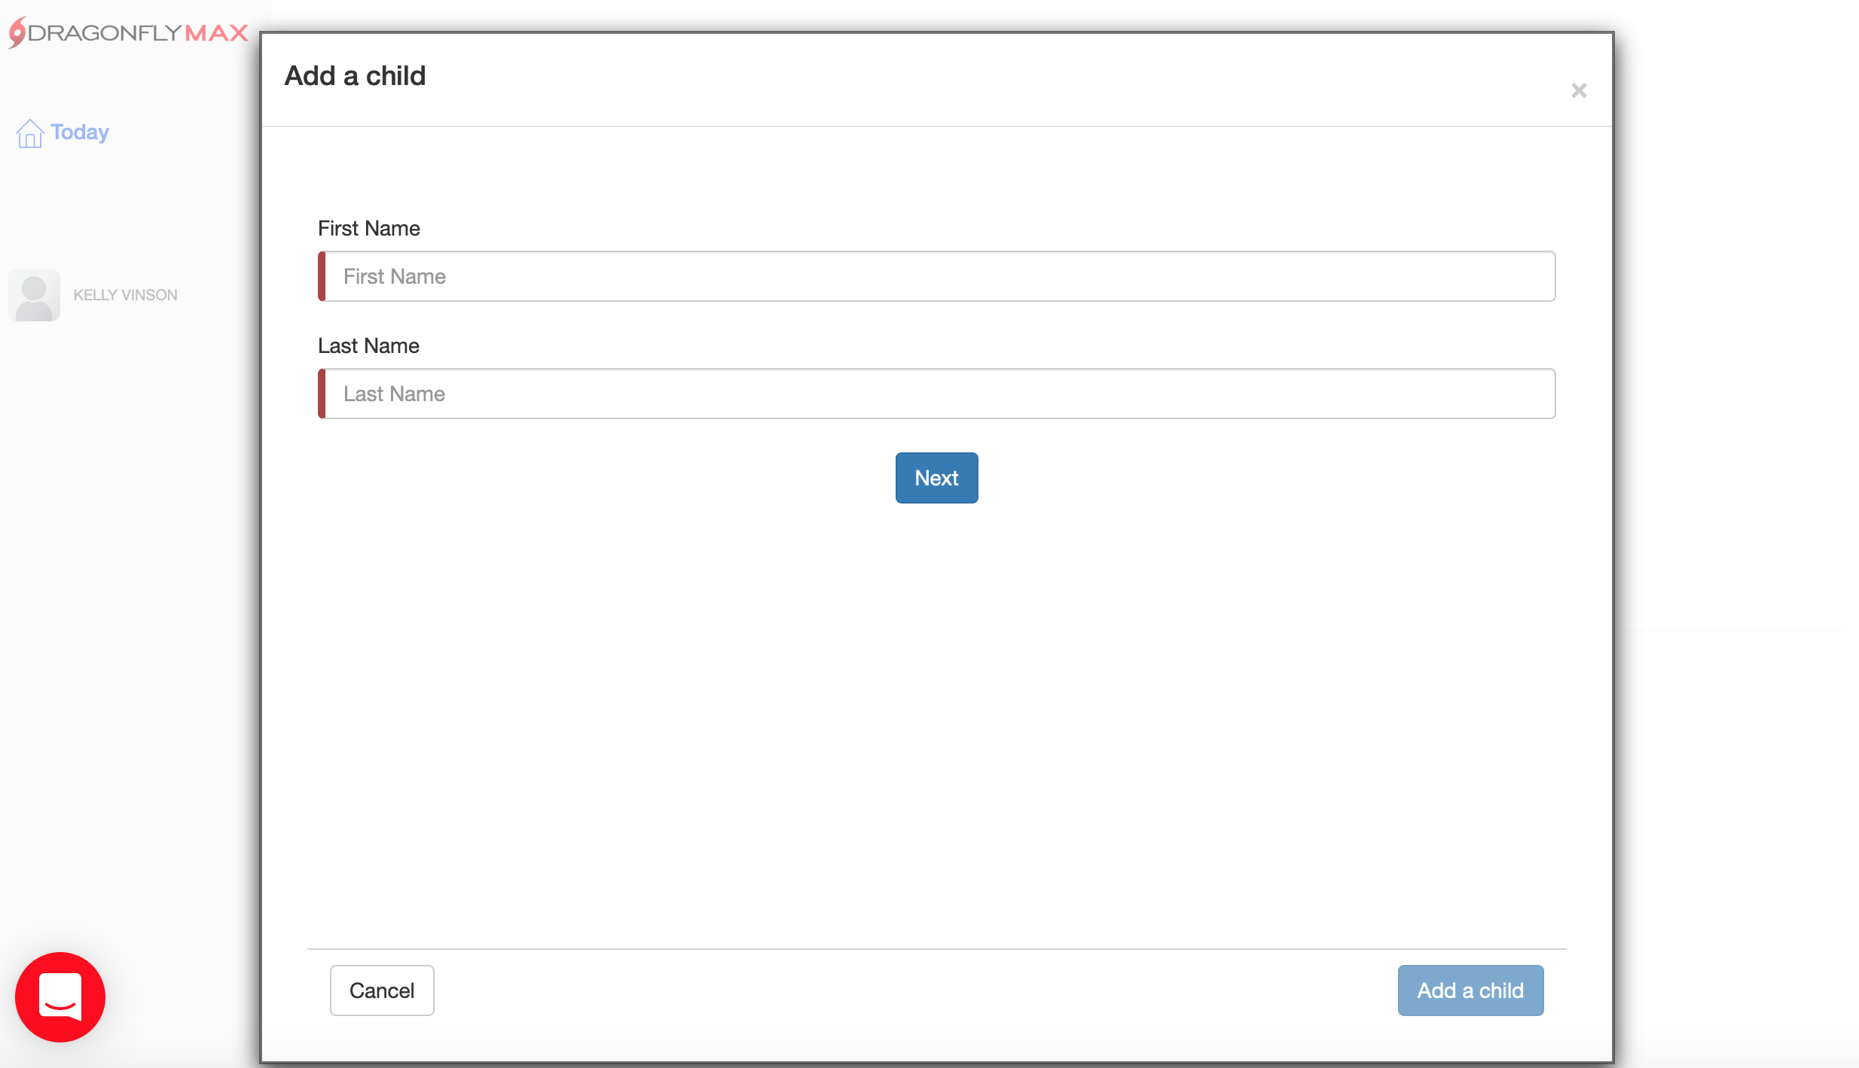

Slide 10
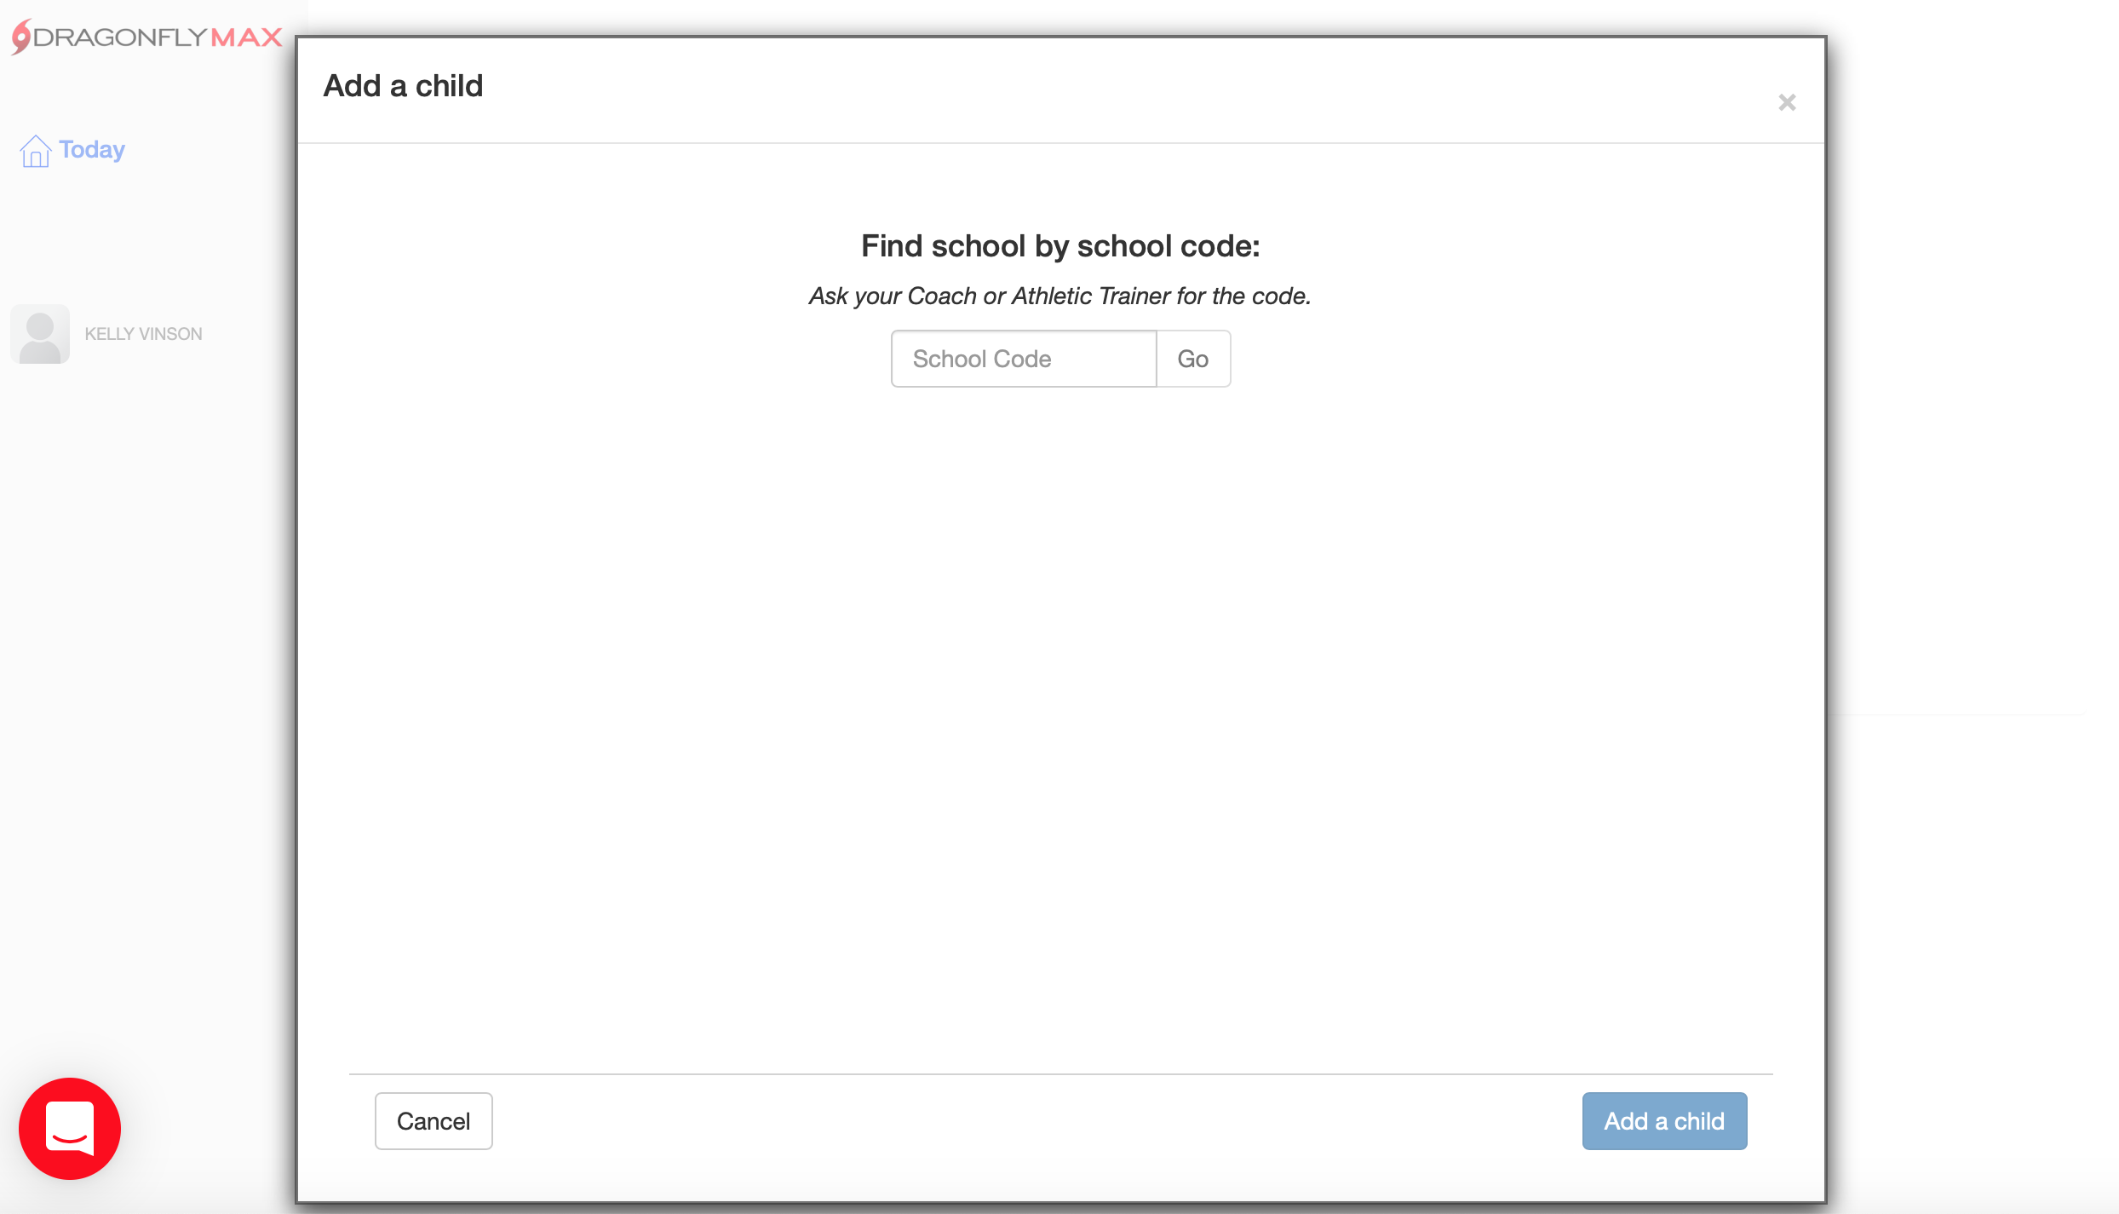
889VCG

Slide 11
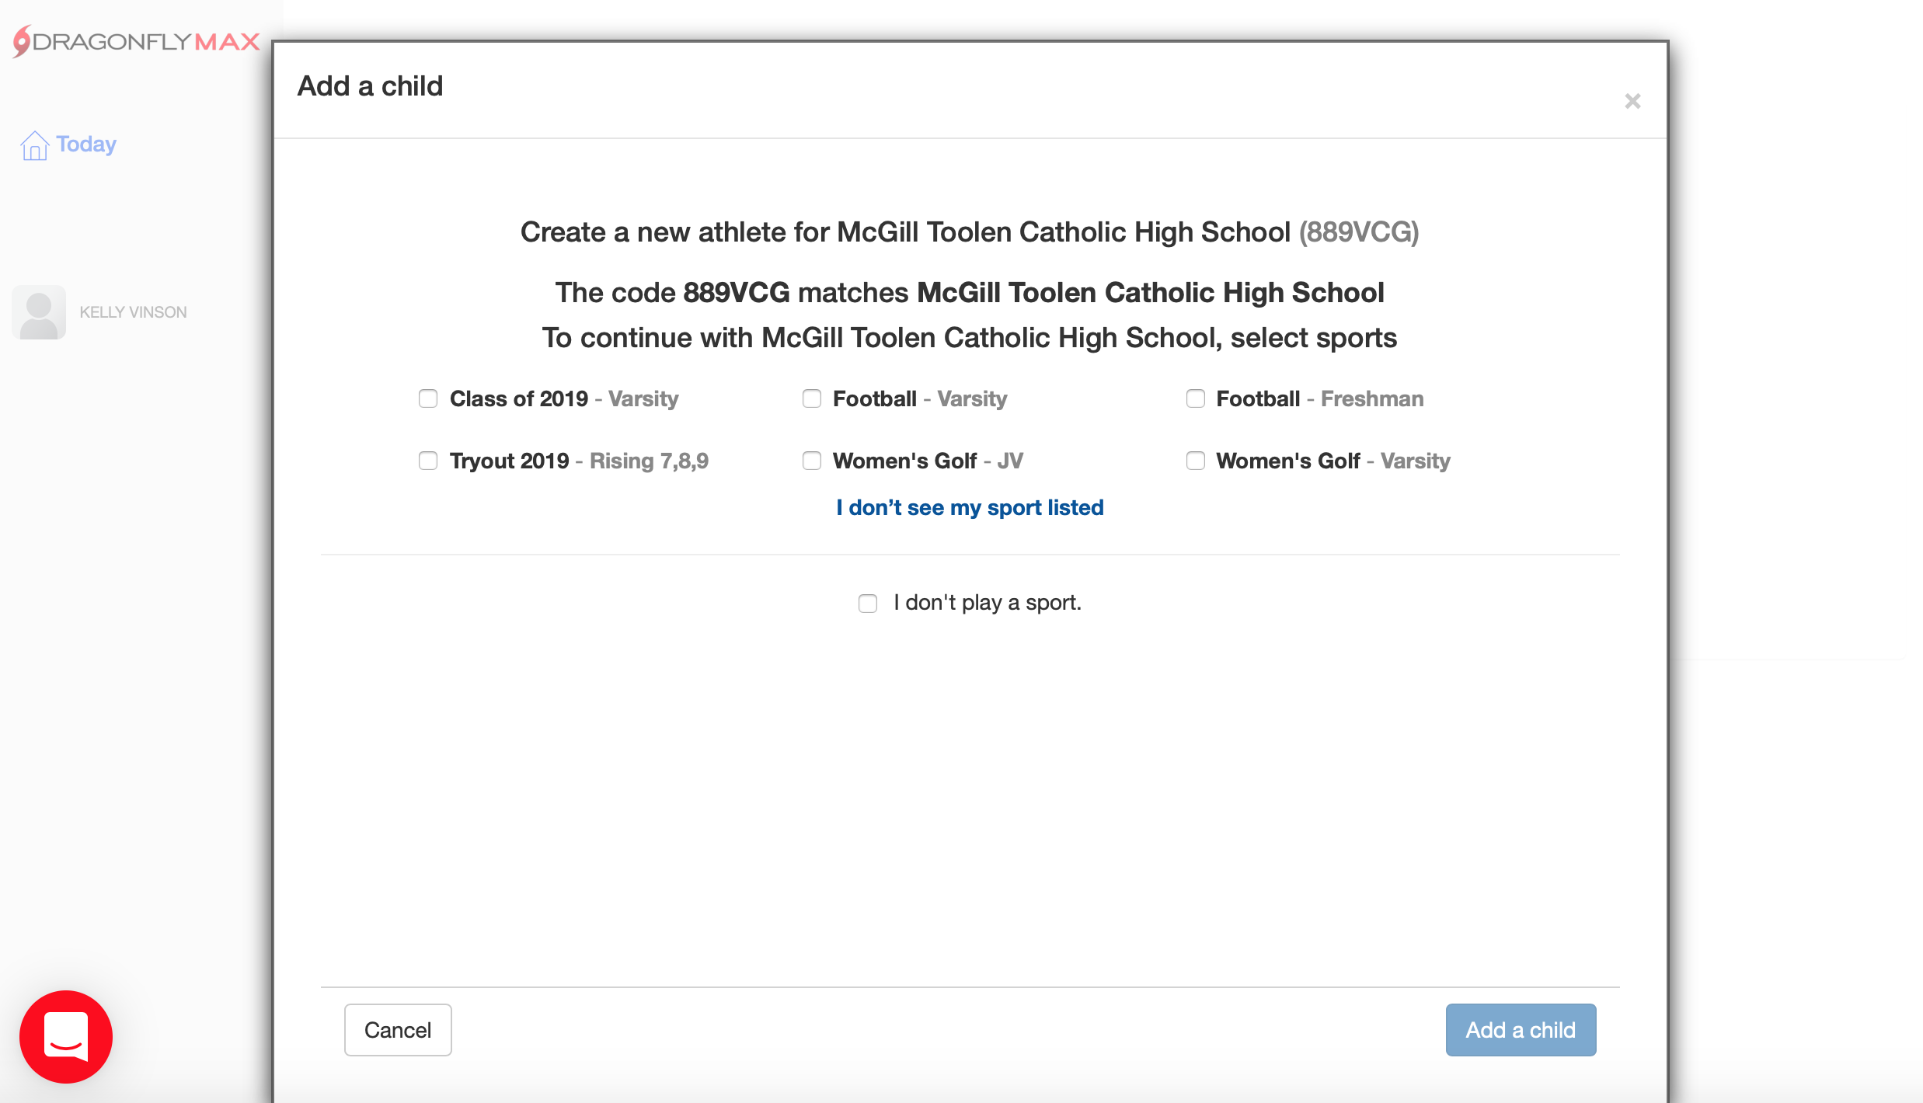
New Athletes → Tryout 2019
Current Athlete @ McT→ Pick all sports that apply

Slide 12
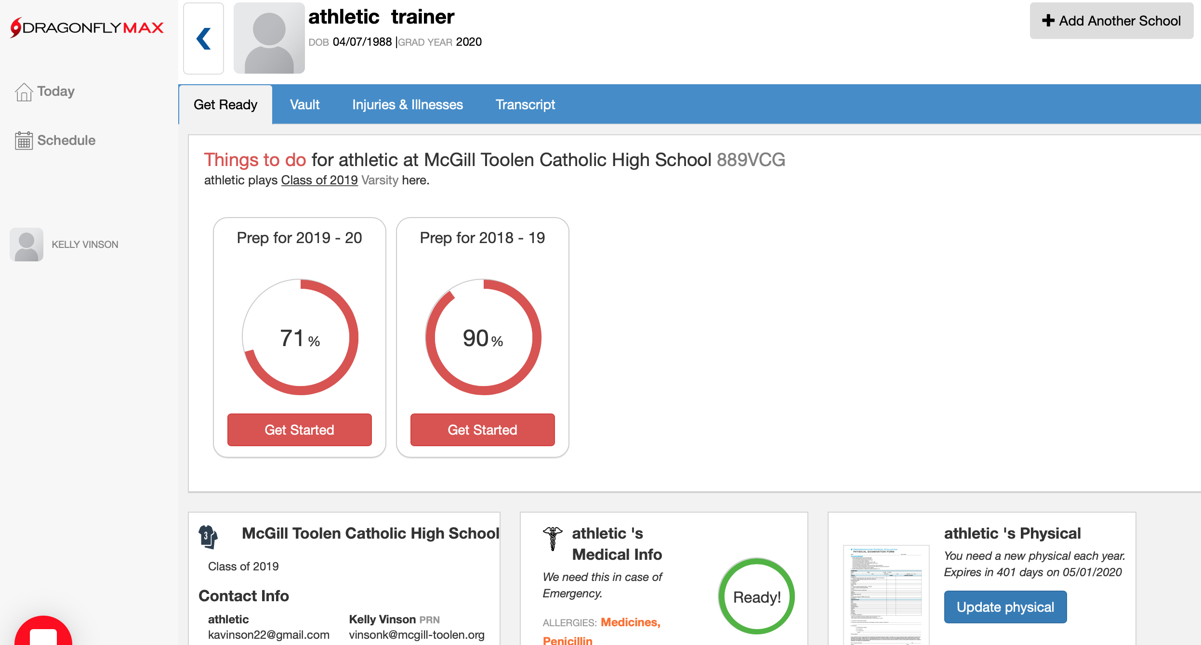
← Select 2018-2019 to be ready for Tryouts (volleyball, basketball, football, cheerleading, bowling, cross country, track, swim/dive)
→
Select 2019-20 If tryouts aren’t until the Fall of 2019 (baseball, soccer, tennis, golf, softball, outdoor track)

Slide 13
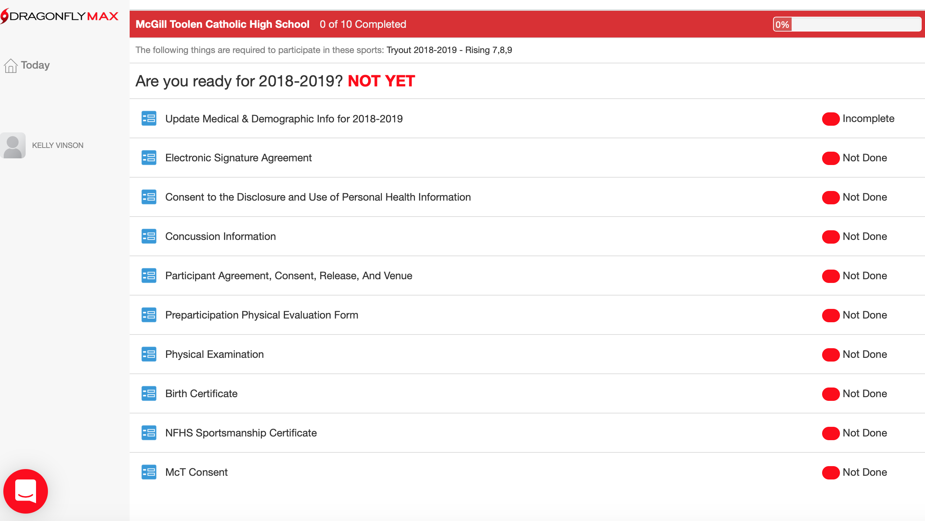
← These 4 forms need to be updated annually.
Notes:
These 4 will need to be updated annually.

Slide 14
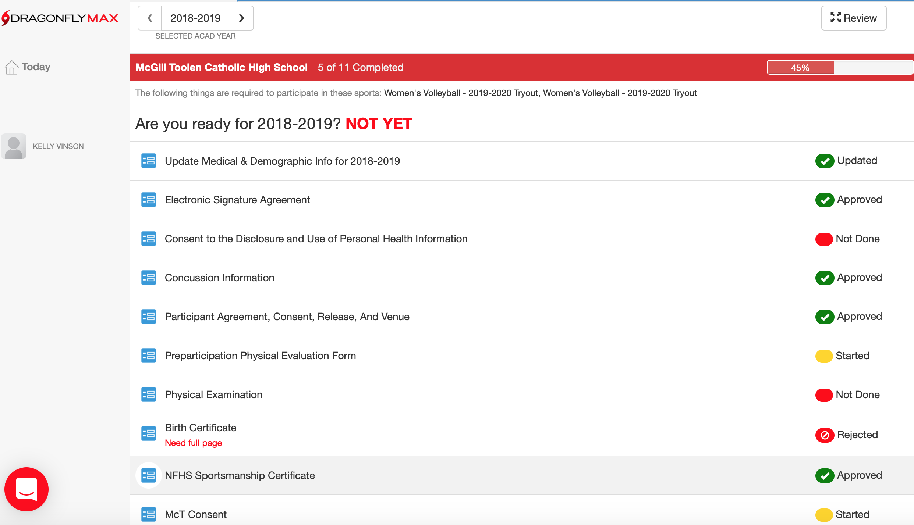
Check back periodically after submitting forms to make sure your athlete is READY and nothing has been rejected.
Notes:
Check back to make sure your athlete is READY and nothing has been rejected.

Slide 15
Sportsmanship Course
https://nfhslearn.com
Register
Click “courses”
Scroll down to “sportsmanship”
Click “view course”
Click “order course”– it’s FREE when you checkout
When completed, upload certificate to Dragonfly

Slide 16
Physical rev. 2018
McGill-Toolen website
Athletics tab
Required Forms
Physical Evaluation

Slide 17
QUESTIONS??
Dragonfly online help center
vinsonk@mcgill-toolen.org
zakutng@mcill-toolen.org
251-445-2925

